Slide 1
E-commerce Website
Company: Dynamic Technosoft Pvt.Ltd. Sweta Kumari
17BCE2388

Slide 2
Introduction
A 5-week internship training in Dynamic Technosoft Pvt.Ltd. in I.T. Department.
Project Assigned : E-commerce Website (Web application)
Application: For managing the requests generated for demand of S/W based components
This portal was deployed on xampp server
Many new concepts and new learnings were made by me
I was first time exposed to the real-corporate world.

Slide 3
Continued
A basic introduction about the websites like GitHub repository was given and I had to go through the codes to get some idea about the Xampp usage.
I was introduced to PHP framework for backend creation.
A basic login form had to be designed with the help of basic HTML which contained major types of sign-in procedures all together like email. They tried to extract how much I know about WEB Development.
The focus of this project was to help the Online shopping for retail sales direct to consumers via Web sites .I have to design a category page where all the products where displayed and the user can add the product to their cart.

Slide 4
Aim of the project
Developing a GUI based automated system, which will cover all the information Related to the all products which is used in our daily life. For example – Mobiles Phones, Laptops, Clothes, Books, Electronic Items and many more.
E-commerce is mainly useful for ho haven’t time to go shopping or for comfortably to the customers. Those are just entered into this website and bought they want at any time they can visit the web-site.
Those are just entered into this website and bought they want at any time they can visit the web-site. Customer will choose different items like mobile, laptops, etc.

Slide 5
Objective
The “Ecommerce” is developed according the current need in different Fields. This is Ecommerce Website which provides facility for purchasing Mobiles, Laptops, tabs and many more items.
By using this system users which want to purchase some products will first Register an account on this portal then Login through their Username and Password, and then Select items which they want to purchase and add them to cart and finally checkout by giving payment details.
Using this portal users can easily purchase products from their home.

Slide 6
Motivation
1. Build a customer email list and market directly to them
2. Establish and strengthen your brand
3. Learn more about your audience
4. Run creative marketing campaigns
5 Marketing Through Social Media & Search Engines

Slide 7

About the Company
Dynamic Technosoft is a recognized leader in the field of IT service providers, providing comprehensive software development and web products for more than a decade.
Dynamic Technosoft company's various services include Software Development, Mobile App Development, Website Development, Bulk SMS Solution, Domain Registration and Web Hosting, and Online attendance Solution.
One-stop-shop concept Dynamic makes it possible for our clients to outsource solutions for all of their needs conveniently.
Dynamic Vision is to constantly adapt and broaden our range of services to reflect the future needs of our customers.

Slide 8
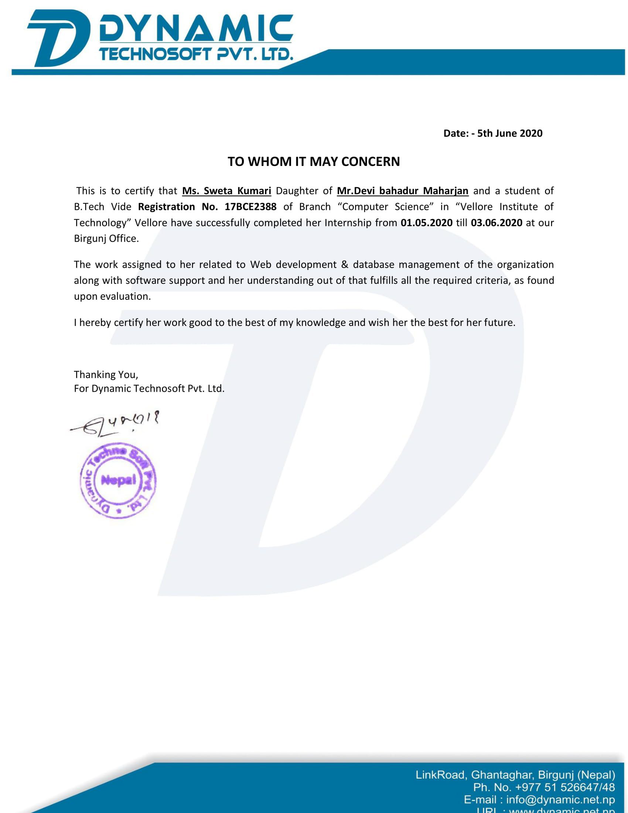
Certificate

Slide 9
Skills before internship / Skills gained from curriculum
Some of the skills which I had acquired from the curriculum, which were required to have in my internship:
Data structures and algorithms
Back-end part in web development – PHP and HTML
Open source programming
Networks and communication
Database Management System
Software Engineering

Slide 10
Knowledge acquired during training
Technical Skills:
Network and connection specifically among their systems
LDAP server
SSO (Single Sign-On)
MSSQL with XAMPP server
Frontend-side of web development
Making the web application from http to https (that is from unsecured to secured)
Providing and maintaining the privileges
Putting up the web application over the server

Slide 11
Knowledge acquired during training
Managerial learnings:
Management for any request made
Group tasks carried out in synchronization
Managing any customer on call
Communication among members using Skype
Time Management
Experiment, Analyze and Reconstruct

Slide 12
Application of skill set - The Project
Skill sets learned applied in the project assigned to me,’ E-commerce Website.
A web Application
Application: Manage the order placed by the customers and giving the customers a list of many products from which they can choose and buy from the store and the details about the product with reviews from people.
Purpose: Convert a manual and unsecured system to a semi-automated secured system which people can use with proper safety and trust.

Slide 13
Users of the Application
There are five types of users to be considered for this application:
Requester
Administrator (admin)
Acceptors (at four levels)
Procurement team
Suppliers

Slide 14
Earlier System
Faults in the earlier system:
Requesters used to send email which didn’t had any consistent format
The request was recorded in an excel file by the admin
Admin used to manually find and enter the data from mails to system and had to save the attachments at an appropriate place
Admin had to manually send mail to each and every person
Double entry of request was to be created one in excel.

Slide 15
Proposed and designed system
A request form was designed for requesters so there is consistency maintained when request is sent.
Data was stored in Microsoft SQL Server, which made data secured as well as integrated.
Admin gave the privileges to different users.
Only authenticated and authorized person is able to access the system.
The process of fulfilling the request becomes faster.

Slide 16
Functionalities of each user
Requester:
Submit request
View its updates
View past requests
Admin:
Views the request
Make modification as per requirement
Manage Application Data
Provide privileges
Add/remove/modify the users

Slide 17
Functionalities of each user
Acceptors / approvers:
Approve or reject the request
Feedback if minor change required in request
Procurement team and suppliers:
Fulfil the requirement
Indicate to system the status of fulfilment of request

Slide 18
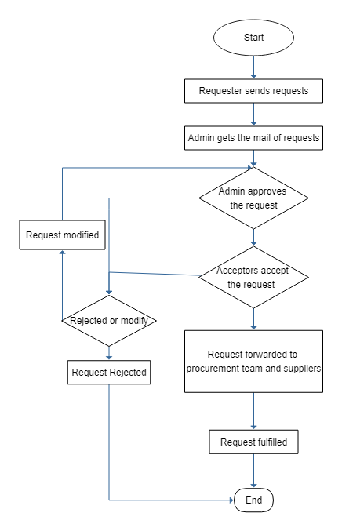
Process flow

Slide 19
Some other sub-processes
System registration and login
Required LDAP
Privileges by admin
Updating in fields in real time
Real-time update in database as well as its reflection on web page

Slide 20
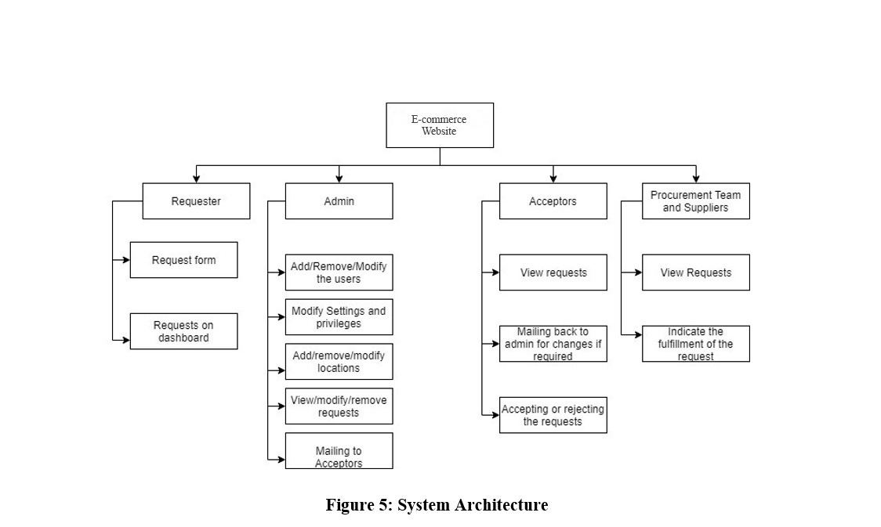
Architecture

Slide 21
System Components
Microsoft Server 2016 OS
XAMPP
Microsoft SQL Server 2019
MSSQL drivers
PHP 7.2 and above
Supported Web browsers:
LDAP server

Slide 22
Modules and Libraries
DataTables
jQuery plugin
Used to manage the tables on front-end web page
Bootstrap
Framework of CSS, JS and HTML
Used for designing the interactive and dynamic web pages

Slide 23
Conclusion
Difference is the world outside and world in our comfort zone
Gained technical knowledge as well as non-technical knowledge existing in corporate companies.
Got to know how each and every procedure is taken in a critical manner.
Learnt about management in company
It was good journey with an experiential learning

